Slide 1

Meow-some
Mansion
START

Slide 2
Meow-some
Mansion
START

Slide 3
Meow-some
Mansion
START

Slide 4
Meow-some
Mansion
START

Slide 5
Meow-some
Mansion
START

Slide 6
How can I call you?

Slide 7
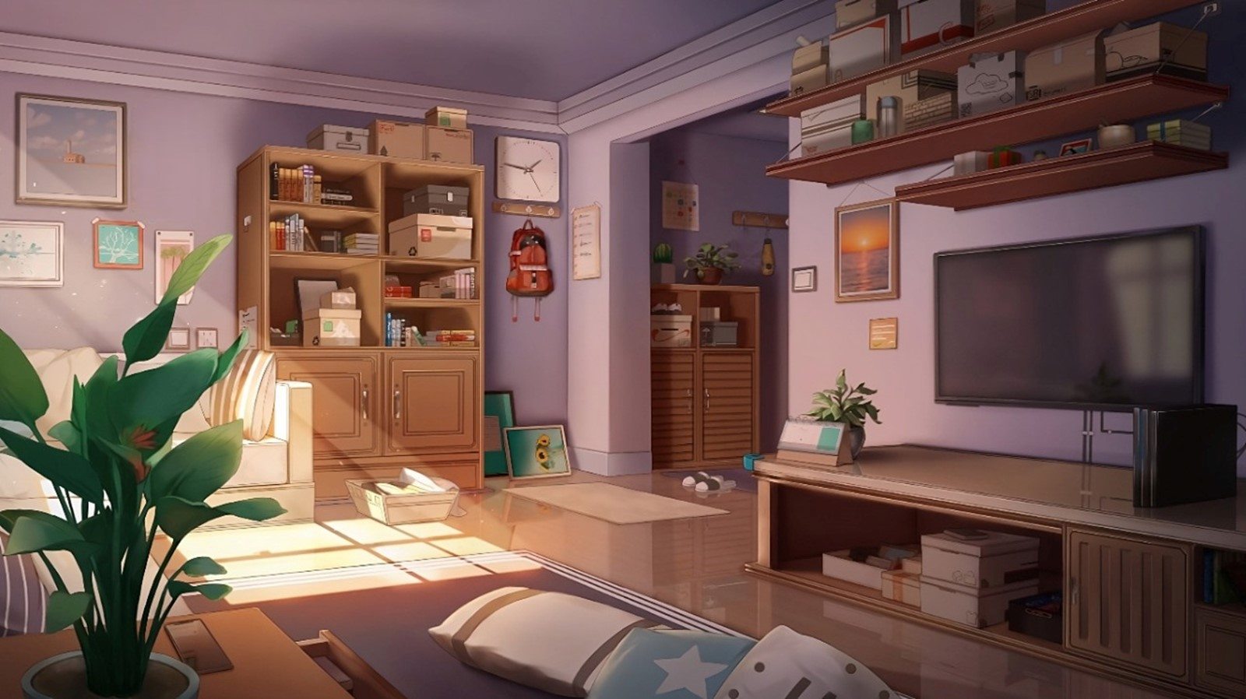
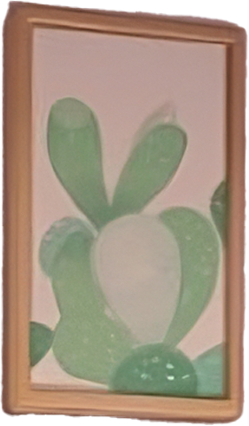

Hello
Johnny
, welcome to my house and this is my living room.
I’m so glad you’re here.
Lucky

Slide 8

Thank you for having me over, Lucky
Johnny

Slide 9
…
Johnny

Slide 10
Your room is so beautiful!
Johnny

Slide 11

Thank you! But I’m afraid it’s a bit of a mess right now. Do you think you could help me clean it up?
Sure! That sounds like fun.
I’m sorry, I’d love to help, but I’m allergic to dust.
Lucky

Slide 12
Thank you! But I’m afraid it’s a bit of a mess right now. Do you think you could help me clean it up?
Sure! That sounds like fun.
I’m sorry, I’d love to help, but I’m allergic to dust.
Lucky

Slide 13
Thank you! But I’m afraid it’s a bit of a mess right now. Do you think you could help me clean it up?
Sure! That sounds like fun.
I’m sorry, I’d love to help, but I’m allergic to dust.
Lucky

Slide 14

Oh, I see.
Lucky

Slide 15

That’s okay! We can find something else to do. How about watching the TV?
Lucky

Slide 16


Slide 17

Hm, ok let’s start
Lucky

Slide 18




Slide 19
https://www.pngwing.com/en/free-png-bcuod/download

